Slide 1
SQL Session 3 Table constraints

Slide 2
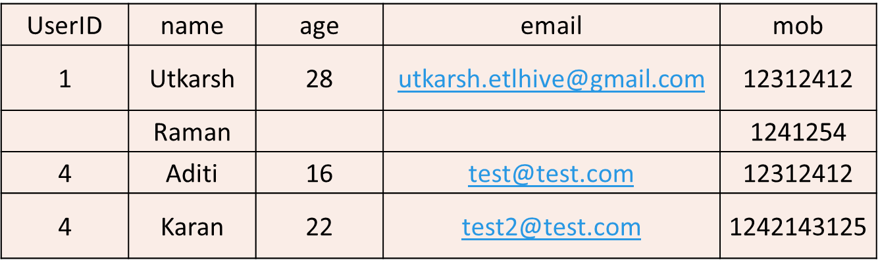
Errors that can happen while entering values

Slide 3
Table Constraints in SQL
Types of Table Constraints:
NOT NULL Constraint: Ensures that a column cannot have a NULL value.
UNIQUE Constraint: Ensures that all values in a column are unique.
PRIMARY KEY Constraint: A combination of NOT NULL and UNIQUE constraints. It ensures that a column or set of columns uniquely identify each row in the table.
FOREIGN KEY Constraint: Ensures that values in a column (or a set of columns) match the values in a column(s) of another table (i.e., references the primary key of another table).
CHECK Constraint: Ensures that the data entered in a column satisfies a specific condition.
DEFAULT Constraint: Provides a default value for a column when no value is specified.

Slide 4
Syntax for table constraints
CREATE TABLE table_name (
Column1 datatype1 constraint1,
Column2 datatype2 constraint2,
…..);

Slide 5
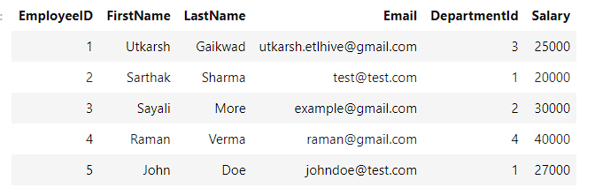
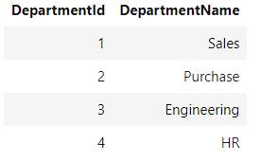
Foreign Key vs Primary Key
Employee
Department
Primary Key
For Employee Table
Foreign Key for
Employee Table
Primary Key
For Department Table

Slide 6
Departments table
CREATE TABLE Departments (
DepartmentID INT PRIMARY KEY,
DepartmentName VARCHAR(50) NOT NULL
);

Slide 7
Employees Table
CREATE TABLE Employees (
EmployeeID INT PRIMARY KEY,
FirstName VARCHAR(50) NOT NULL,
LastName VARCHAR(50) NOT NULL,
Email VARCHAR(100) UNIQUE,
DepartmentID INT NOT NULL,
Salary DECIMAL(10, 2) CHECK (Salary > 0),
HireDate DATE DEFAULT '2023-01-01’,
FOREIGN KEY (DepartmentID) REFERENCES DEPARTMENT(DepartmentID) );

Slide 8
Date format
yyyy-mm-dd

Slide 9
Thank You
For Any Queries ping me on skype group

